Slide 1

CSE 101 - COMPUTER PROGRAMMING I
Arrays II
Joseph LEDET
Department of Computer Engineering
Akdeniz University
josephledet@akdeniz.edu.tr

Slide 2
Motivations
Thus far, you have used one-dimensional arrays to model linear collections of elements. You can use a two-dimensional array to represent a matrix or a table. For example, the following table that describes the distances between the cities can be represented using a two-dimensional array.

Slide 3
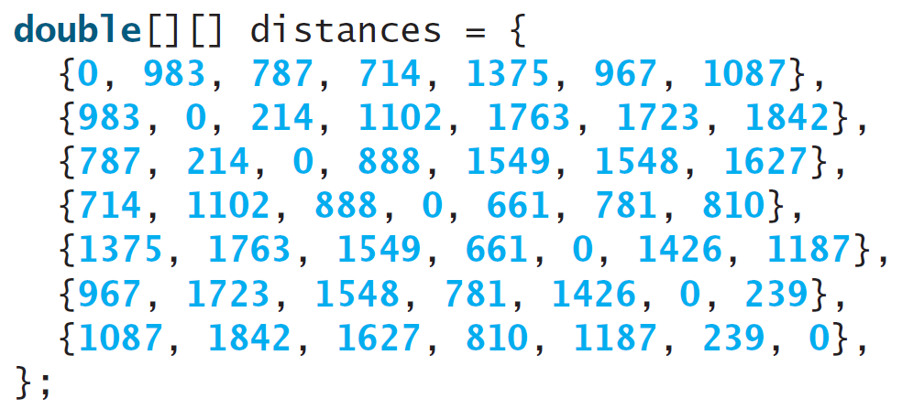
Motivations

Slide 4
Objectives
To give examples of representing data using two-dimensional arrays (§8.1).
To declare variables for two-dimensional arrays, create arrays, and access array elements in a two-dimensional array using row and column indexes (§8.2).
To program common operations for two-dimensional arrays (displaying arrays, summing all elements, finding the minimum and maximum elements, and random shuffling) (§8.3).
To pass two-dimensional arrays to methods (§8.4).
To write a program for grading multiple-choice questions using two-dimensional arrays (§8.5).
To solve the closest-pair problem using two-dimensional arrays (§8.6).
To check a Sudoku solution using two-dimensional arrays (§8.7).
To use multidimensional arrays (§8.8).

Slide 5
Declare/Create Two-dimensional Arrays
// Declare array ref var
dataType[][] refVar;
// Create array and assign its reference to variable
refVar = new dataType[10][10];
// Combine declaration and creation in one statement
dataType[][] refVar = new dataType[10][10];
// Alternative syntax
dataType refVar[][] = new dataType[10][10];

Slide 6
Declaring Variables of Two-dimensional Arrays and Creating Two-dimensional Arrays
int[][] matrix = new int[10][10];
or
int matrix[][] = new int[10][10];
matrix[0][0] = 3;
for (int i = 0; i < matrix.length; i++)
for (int j = 0; j < matrix[i].length; j++)
matrix[i][j] = (int)(Math.random() * 1000);
double[][] x;

Slide 7
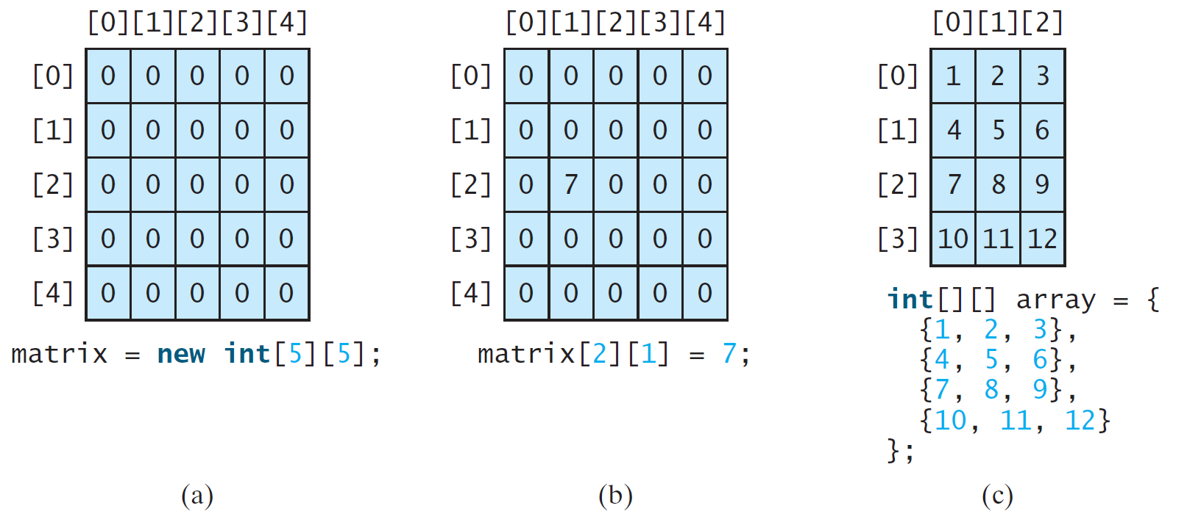
Two-dimensional Array Illustration
matrix.length? 5
matrix[0].length? 5
array.length? 4
array[0].length? 3

Slide 8
Declaring, Creating, and Initializing Using Shorthand Notations
You can also use an array initializer to declare, create and initialize a two-dimensional array. For example,
int[][] array = {
{1, 2, 3},
{4, 5, 6},
{7, 8, 9},
{10, 11, 12}
};
int[][] array = new int[4][3];
array[0][0] = 1; array[0][1] = 2; array[0][2] = 3;
array[1][0] = 4; array[1][1] = 5; array[1][2] = 6;
array[2][0] = 7; array[2][1] = 8; array[2][2] = 9;
array[3][0] = 10; array[3][1] = 11; array[3][2] = 12;
Same as

Slide 9
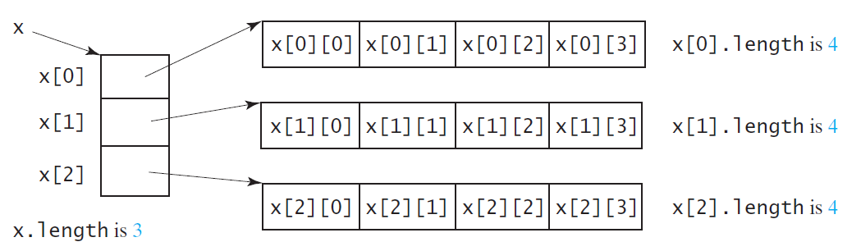
Lengths of Two-dimensional Arrays
int[][] x = new int[3][4];

Slide 10
Lengths of Two-dimensional Arrays, cont.
array.length
array[0].length
array[1].length
array[2].length
array[3].length
int[][] array = {
{1, 2, 3},
{4, 5, 6},
{7, 8, 9},
{10, 11, 12}
};
array[4].length ArrayIndexOutOfBoundsException

Slide 11
Ragged Arrays
Each row in a two-dimensional array is itself an array. So, the rows can have different lengths. Such an array is known as a ragged array. For example,
int[][] matrix = {
{1, 2, 3, 4, 5},
{2, 3, 4, 5},
{3, 4, 5},
{4, 5},
{5}
};
matrix.length is 5
matrix[0].length is 5
matrix[1].length is 4
matrix[2].length is 3
matrix[3].length is 2
matrix[4].length is 1
int[][] arr = new int[5][5, 4, 3, 2, 1]

Slide 12
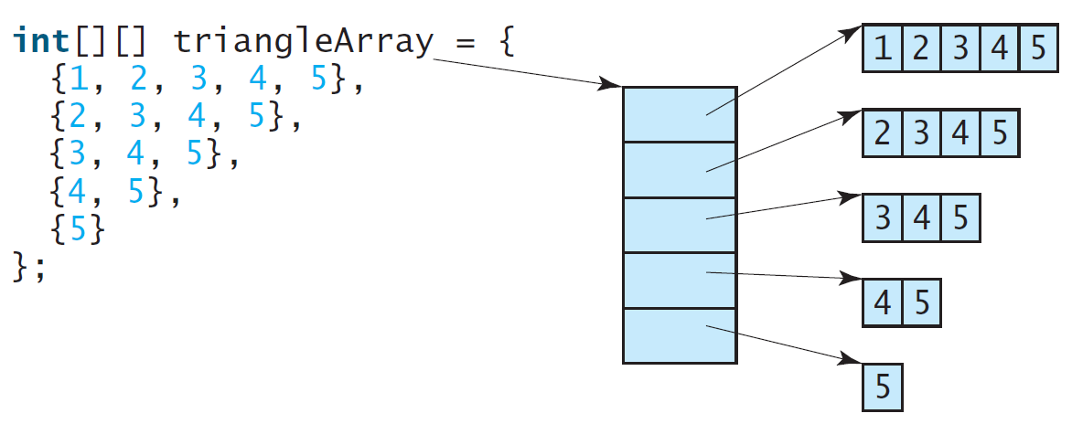
Ragged Arrays, cont.

Slide 13
Processing Two-Dimensional Arrays
See the examples in the text.
(Initializing arrays with input values)
(Printing arrays)
(Summing all elements)
(Summing all elements by column)
(Which row has the largest sum)
(Finding the smallest index of the largest element)
(Random shuffling)

Slide 14
Initializing arrays with input values
java.util.Scanner input = new Scanner(System.in);
System.out.println("Enter " + matrix.length + " rows and " +
matrix[0].length + " columns: ");
for (int row = 0; row < matrix.length; row++) {
for (int column = 0; column < matrix[row].length; column++) {
matrix[row][column] = input.nextInt();
}
}

Slide 15
Initializing arrays with random values
for (int row = 0; row < matrix.length; row++) {
for (int column = 0; column < matrix[row].length; column++) {
matrix[row][column] = (int)(Math.random() * 100);
}
}

Slide 16
Printing arrays
for (int row = 0; row < matrix.length; row++) {
for (int column = 0; column < matrix[row].length; column++) {
System.out.print(matrix[row][column] + " ");
}
System.out.println();
}

Slide 17
Summing all elements
int total = 0;
for (int row = 0; row < matrix.length; row++) {
for (int column = 0; column < matrix[row].length; column++) {
total += matrix[row][column];
}
}

Slide 18
Summing elements by column
for (int column = 0; column < matrix[0].length; column++) {
int total = 0;
for (int row = 0; row < matrix.length; row++)
total += matrix[row][column];
System.out.println("Sum for column " + column + " is "
+ total);
}

Slide 19
Random shuffling
for (int i = 0; i < matrix.length; i++) {
for (int j = 0; j < matrix[i].length; j++) {
int i1 = (int)(Math.random() * matrix.length);
int j1 = (int)(Math.random() * matrix[i].length);
// Swap matrix[i][j] with matrix[i1][j1]
int temp = matrix[i][j];
matrix[i][j] = matrix[i1][j1];
matrix[i1][j1] = temp;
}
}

Slide 20
Passing Tow-Dimensional Arrays to Methods
PassTwoDimensionalArray
Run

Slide 21
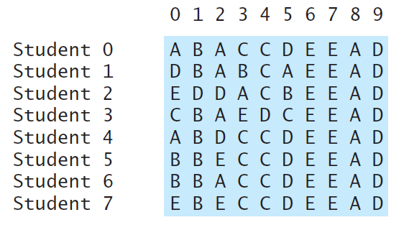
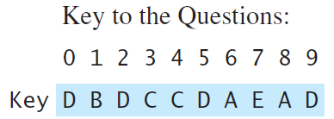
Problem: Grading Multiple-Choice Test
Students’ answer
Objective: write a program that grades multiple-choice test.
GradeExam
Run

Slide 22
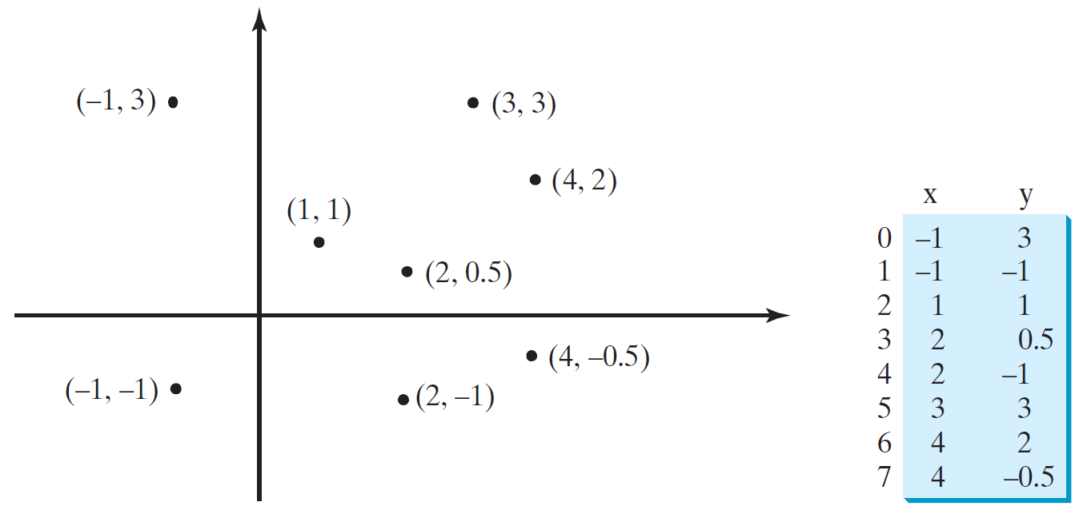
Problem: Finding Two Points Nearest to Each Other
FindNearestPoints
Run

Slide 23
What is Sudoku?

Slide 24
Every row contains the numbers 1 to 9

Slide 25
Every column contains the numbers 1 to 9
5 3
4
6
7
8
9
1
2
6
7
2
1 9 5
3
4
8
1
9 8
3
4
2
5
6
7
8
5
9
7
6
1
4
2
3
4
2
6
8
5
3
7
9
1
7
1
3
9
2
4
8
5
6
9
6
1
5
3
7
2
8
4
2
8
7
4 1 9
6
3
5
3
4
5
2
8
6
1
7 9

Slide 26
Every 3×3 box contains the numbers 1 to 9
5 3
4
6
7
8
9
1
2
6
7
2
1 9 5
3
4
8
1
9 8
3
4
2
5
6
7
8
5
9
7
6
1
4
2
3
4
2
6
8
5
3
7
9
1
7
1
3
9
2
4
8
5
6
9
6
1
5
3
7
2
8
4
2
8
7
4 1 9
6
3
5
3
4
5
2
8
6
1
7 9

Slide 27
Checking Whether a Solution Is Correct
CheckSudokuSolution
Run

Slide 28
Multidimensional Arrays
Occasionally, you will need to represent n-dimensional data structures. In Java, you can create n-dimensional arrays for any integer n.
The way to declare two-dimensional array variables and create two-dimensional arrays can be generalized to declare n-dimensional array variables and create n-dimensional arrays for n >= 3.

Slide 29
Multidimensional Arrays
double[][][] scores = {
{{7.5, 20.5}, {9.0, 22.5}, {15, 33.5}, {13, 21.5}, {15, 2.5}},
{{4.5, 21.5}, {9.0, 22.5}, {15, 34.5}, {12, 20.5}, {14, 9.5}},
{{6.5, 30.5}, {9.4, 10.5}, {11, 33.5}, {11, 23.5}, {10, 2.5}},
{{6.5, 23.5}, {9.4, 32.5}, {13, 34.5}, {11, 20.5}, {16, 7.5}},
{{8.5, 26.5}, {9.4, 52.5}, {13, 36.5}, {13, 24.5}, {16, 2.5}},
{{9.5, 20.5}, {9.4, 42.5}, {13, 31.5}, {12, 20.5}, {16, 6.5}}};

Slide 30
Problem: Calculating Total Scores
Objective: write a program that calculates the total score for students in a class. Suppose the scores are stored in a three-dimensional array named scores. The first index in scores refers to a student, the second refers to an exam, and the third refers to the part of the exam. Suppose there are 7 students, 5 exams, and each exam has two parts--the multiple-choice part and the programming part. So, scores[i][j][0] represents the score on the multiple-choice part for the i’s student on the j’s exam. Your program displays the total score for each student.
TotalScore
Run

Slide 31
Problem: Weather Information
Suppose a meteorology station records the temperature and humidity at each hour of every day and stores the data for the past ten days in a text file named weather.txt. Each line of the file consists of four numbers that indicate the day, hour, temperature, and humidity. Your task is to write a program that calculates the average daily temperature and humidity for the 10 days.
Weather
Run

Slide 32
Problem: Guessing Birthday
Listing 4.3, GuessBirthday.java, gives a program that guesses a birthday. The program can be simplified by storing the numbers in five sets in a three-dimensional array, and it prompts the user for the answers using a loop.
GuessBirthdayUsingArray
Run

